Slide 1

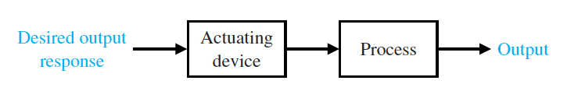
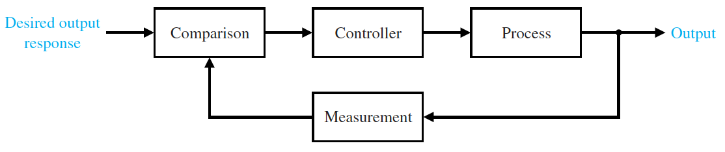
ةرطﯾﺳﻟا ﺔﺳدﻧھ ةدﺎﻣ تارﺿﺎ ﺔﯾﺣﺎﺑﺻاﻟﺔﺳارداﻟ– ﺔﺛﻟﺎﺛﻟا ﺔﻠﺣرﻣاﻟ ﻰﻟواﻷةرﺿﺎﺣﻣاﻟ
------------------------------------------------------------
------------------
ﻲﻣﻠﻌﻟا ثﺣﺑﻟاو ﻲﻟﺎﻌﻟا مﯾﻠﻌﺗﻟا ةرا ﺔﺳدﻧﮭﻟا ﺔﯾ - ﻰﻟﺎﯾد ﺔﻌﻣ
ﺔﯾﺋﺎﺑرﮭﻛاﻟنﺋﺎﻛﻣﻟاو ةردﻘﻟا ﺔﺳد مﻗﺳ
-------------------------------------------------------
A control system manages, commands, directs, or regulates the behaviour of other devices or systems using control loops. It can range from a single home heating controller using a thermostat controlling a domestic boiler to large systems which are used for controlling processes or machines.
Automatic control has become an important and integral part of modern manufacturing and industrial processes. For example, automatic control is essential in such industrial operations as controlling pressure, temperature, humidity, …
Open-loop control system utilizes a controller or control actuator to obtain the desired response, as shown in Figure 1.1. An open-loop system is a system without feedback.
Figure 1.1: Open-loop control system.
In contrast to an open-loop control system, a closed-loop control system utilizes an additional measure of the actual output to compare the actual output with the desired output response. The measure of the output is called the feedback signal. A simple closed-loop feedback control system is shown in Figure 1.2 [1].
Figure 1.2: Closed-loop control system with feedback.
Example: The Air conditioner in the room is similar to the layout in Figure 1.2:

Slide 2
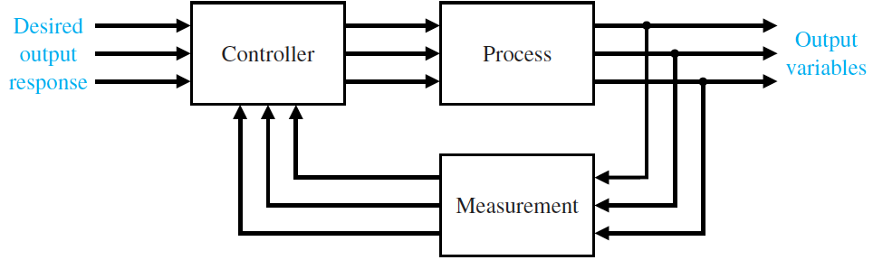
ةرطﯾﺳﻟا ﺔﺳدﻧھ ةدﺎﻣ تارﺿﺎ ﺔﯾﺣﺎﺑﺻاﻟﺔﺳارداﻟ– ﺔﺛﻟﺎﺛﻟا ﺔﻠﺣرﻣاﻟ ﻰﻟواﻷةرﺿﺎﺣﻣاﻟ
------------------------------------------------------------
------------------
ﻲﻣﻠﻌﻟا ثﺣﺑﻟاو ﻲﻟﺎﻌﻟا مﯾﻠﻌﺗﻟا ةرا ﺔﺳدﻧﮭﻟا ﺔﯾ - ﻰﻟﺎﯾد ﺔﻌﻣ
ﺔﯾﺋﺎﺑرﮭﻛاﻟنﺋﺎﻛﻣﻟاو ةردﻘﻟا ﺔﺳد مﻗﺳ
-------------------------------------------------------
Setting the temperature using the remote control = assigning a desired output response of the conditioner.
Process block in Figure 1.2 = the air-conditioner (the motor plus everything).
Measurement block in Figure 1.2 = the temperature sensor in the air conditioner which is measuring the temperature of the room.
Comparison in Figure 1.2 = desired output (the temperature we assigned in the remote control) – output (the room temperature).
Controller in Figure 1.2 = a device which will turn ON or OFF the air conditioner according to the value of the Comparison.
Therefore, when there is a difference between the temperature we assigned in the remote control and the real room temperature, the value of the comparison will be Non-Zero. So that the controller will Turn ON the air conditioner or keeping it ON if it was already working. Otherwise, the output will be zero and the controller will turn OFF the device.
Due to the increasing complexity of the system under control and the interest in achieving optimum performance, the importance of control system engineering has grown in the past decade. Furthermore, as the systems become more complex, the interrelationship of many controlled variables must be considered in the control scheme. A block diagram depicting a multivariable control system is shown in Figure 1.3. A common example of an open-loop control system is an electric toaster in the kitchen. An example of a closed-loop control system is a person steering an automobile (assuming his or her eyes are open) by looking at the auto’s location on the road and making the appropriate adjustments. The introduction of feedback enables us to control a desired output and can improve accuracy, but it requires attention to the issue of stability of response [1].
Figure 1.3: Multivariable control system.

Slide 3
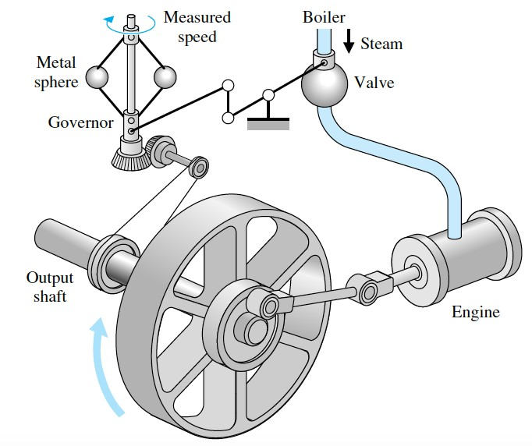
------------------
-------------------------------------------------------
History of Automatic Control.
The automatic control was simply used in the very ancient world like Mesopotamia (Iraq), Egypt, and Greece. In addition, the first feedback system to be invented in modern Europe was the temperature regulator of Cornelis Drebbel (1572–1633) of Holland. Dennis Papin invented the first pressure regulator for steam boilers in 1681. Papin’s pressure regulator was a form of safety regulator
similar to a pressure-cooker valve [1].
The first automatic feedback controller used in an industrial process is generally agreed to be James Watt’s flyball governor, developed in 1769 for controlling the speed of a steam engine [1].
Figure 1.4: Watt’s flyball governor [1].

Slide 4
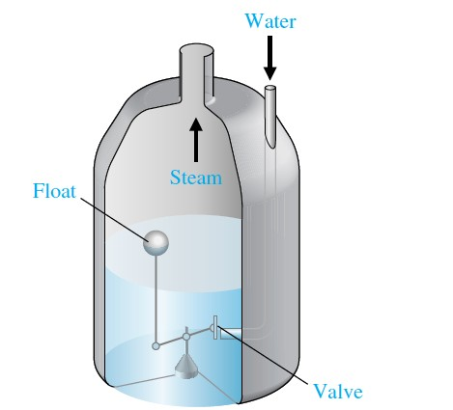
ةرطﯾﺳﻟا ﺔﺳدﻧھ ةدﺎﻣ تارﺿﺎ ﺔﯾﺣﺎﺑﺻاﻟﺔﺳارداﻟ– ﺔﺛﻟﺎﺛﻟا ﺔﻠﺣرﻣاﻟ ﻰﻟواﻷةرﺿﺎﺣﻣاﻟ
------------------------------------------------------------
------------------
ﻲﻣﻠﻌﻟا ثﺣﺑﻟاو ﻲﻟﺎﻌﻟا مﯾﻠﻌﺗﻟا ةرا ﺔﺳدﻧﮭﻟا ﺔﯾ - ﻰﻟﺎﯾد ﺔﻌﻣ
ﺔﯾﺋﺎﺑرﮭﻛاﻟنﺋﺎﻛﻣﻟاو ةردﻘﻟا ﺔﺳد مﻗﺳ
-------------------------------------------------------
The first historical feedback system, claimed by Russia, is the water-level float regulator said to have been invented by I. Polzunov in 1765. The level regulator system is shown in Figure 1.5. The float detects the water level and controls the valve that covers the water inlet in the boiler [1].
Figure 1.5: Water-level float regulator [1].

Slide 5
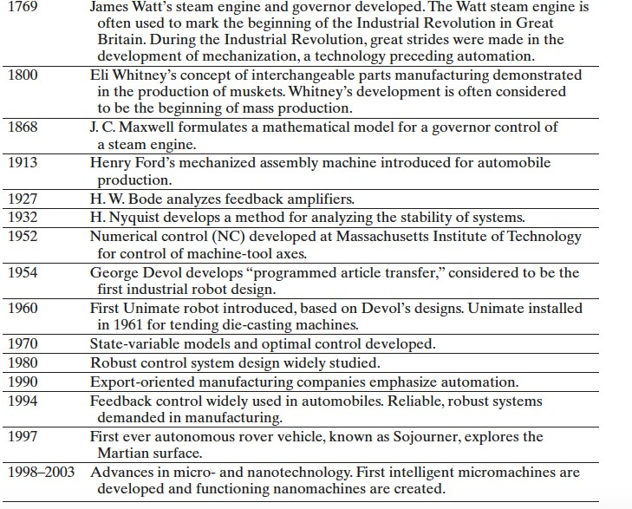
ةرطﯾﺳﻟا ﺔﺳدﻧھ ةدﺎﻣ تارﺿﺎ ﺔﯾﺣﺎﺑﺻاﻟﺔﺳارداﻟ– ﺔﺛﻟﺎﺛﻟا ﺔﻠﺣرﻣاﻟ ﻰﻟواﻷةرﺿﺎﺣﻣاﻟ
------------------------------------------------------------
------------------
ﻲﻣﻠﻌﻟا ثﺣﺑﻟاو ﻲﻟﺎﻌﻟا مﯾﻠﻌﺗﻟا ةرا ﺔﺳدﻧﮭﻟا ﺔﯾ - ﻰﻟﺎﯾد ﺔﻌﻣ
ﺔﯾﺋﺎﺑرﮭﻛاﻟنﺋﺎﻛﻣﻟاو ةردﻘﻟا ﺔﺳد مﻗﺳ
-------------------------------------------------------
Table 1.1: Selected Historical Developments of Control Systems [1].
Control systems are used to achieve (1) increased productivity and (2) improved performance of a device or system. Automation is used to improve productivity and obtain high-quality products.
Automation is the automatic operation or control of a process, device, or system. We utilize automatic control of machines and processes to produce a product within specified tolerances and to achieve high precision [1].

Slide 6
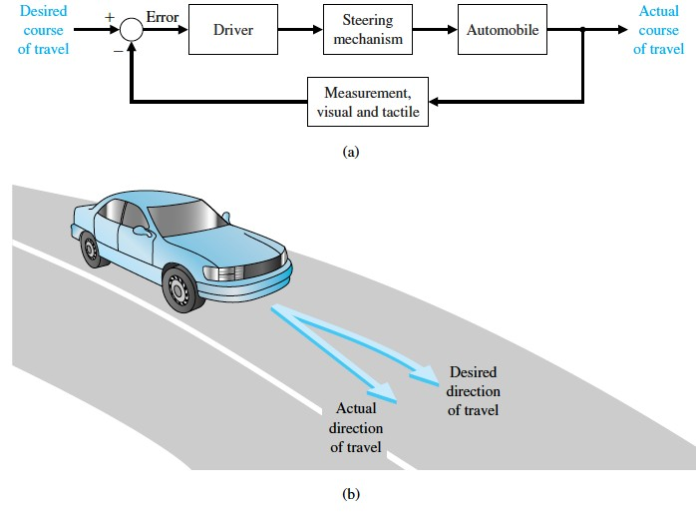
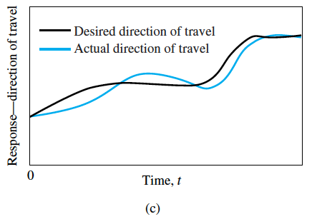
ةرطﯾﺳﻟا ﺔﺳدﻧھ ةدﺎﻣ تارﺿﺎ ﺔﯾﺣﺎﺑﺻاﻟﺔﺳارداﻟ– ﺔﺛﻟﺎﺛﻟا ﺔﻠﺣرﻣاﻟ ﻰﻟواﻷةرﺿﺎﺣﻣاﻟ
------------------------------------------------------------
------------------
ﻲﻣﻠﻌﻟا ثﺣﺑﻟاو ﻲﻟﺎﻌﻟا مﯾﻠﻌﺗﻟا ةرا ﺔﺳدﻧﮭﻟا ﺔﯾ - ﻰﻟﺎﯾد ﺔﻌﻣ
ﺔﯾﺋﺎﺑرﮭﻛاﻟنﺋﺎﻛﻣﻟاو ةردﻘﻟا ﺔﺳد مﻗﺳ
-------------------------------------------------------
Examples of Modern Control Systems.
Example 1: Many cars have power steering and brakes, which utilize hydraulic amplifiers for amplification of the force to the brakes or the steering wheel. A simple block diagram of an automobile steering control system is shown in Figure 1.6(a). The desired course is compared with a measurement of the actual course in order to generate a measure of the error, as shown in Figure
1.6(b). This measurement is obtained by visual and tactile (body movement) feedback. There is an additional feedback from the feel of the steering wheel by the hand (sensor). This feedback system is a familiar version of the steering control system in an ocean liner or the flight controls in a large airplane. A typical direction-of-travel response is shown in Figure 1.6(c) [1].
Figure 1.6: (a) Automobile steering control system. (b) The driver uses the difference between the actual and the desired direction of travel to generate a controlled adjustment of the steering wheel.
(c) Typical direction-of-travel response [1].

Slide 7
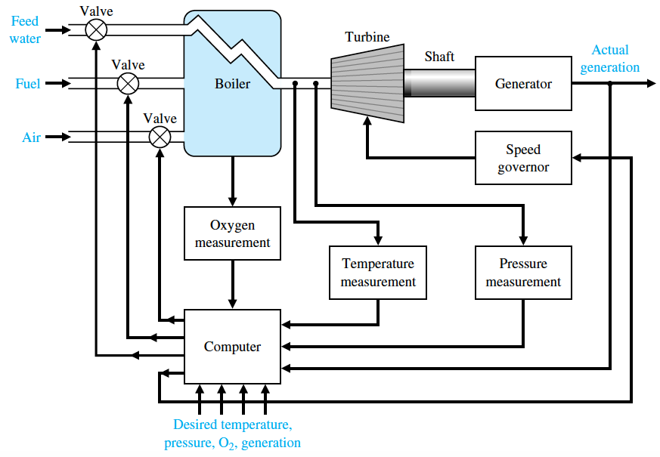
ةرطﯾﺳﻟا ﺔﺳدﻧھ ةدﺎﻣ تارﺿﺎ ﺔﯾﺣﺎﺑﺻاﻟﺔﺳارداﻟ– ﺔﺛﻟﺎﺛﻟا ﺔﻠﺣرﻣاﻟ ﻰﻟواﻷةرﺿﺎﺣﻣاﻟ
------------------------------------------------------------
------------------
ﻲﻣﻠﻌﻟا ثﺣﺑﻟاو ﻲﻟﺎﻌﻟا مﯾﻠﻌﺗﻟا ةرا ﺔﺳدﻧﮭﻟا ﺔﯾ - ﻰﻟﺎﯾد ﺔﻌﻣ
ﺔﯾﺋﺎﺑرﮭﻛاﻟنﺋﺎﻛﻣﻟاو ةردﻘﻟا ﺔﺳد مﻗﺳ
-------------------------------------------------------
Example 2:
Also, the control of power plants for minimum waste emission has become increasingly important. The modern, large-capacity plants, which exceed several hundred megawatts, require automatic control systems that account for the interrelationship of the process variables and optimum power production. It is common to have as many as 90 or more manipulated variables under
coordinated control.
A simplified model showing several of the important control variables of a large boiler– generator system is shown in Figure 1.7. This is an example of the importance of measuring many variables, such as pressure and oxygen, to provide information to the computer for control
calculations. It is estimated that more than 400,000 computer control systems have been installed in the United States [1].
Figure 1.7: Coordinated control system for a boiler–generator [1].
Reference [1]: Chapter 1: ‘Introduction to Control Systems’, available at: http://www.ent.mrt.ac.lk/~rohan/teaching/EN5001/Reading/DORFCH1.pdf

